Slide 1
Project report - bearing
Group2
Bing-Hong Hong
Hsin-Ting Chou
Chih-Hao Chiang
Shao-Tse Chien

Slide 2
Outline
Background
Flow chart
Bearing dataset
Feature extraction
Feature selection
Cross-validation
Model training
conclusion

Slide 3
Background

Slide 4
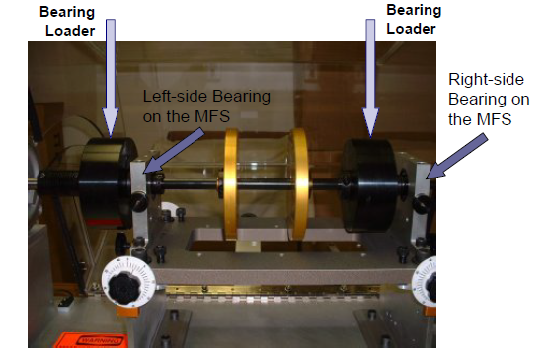
Introduction
Bearing is a machine element that can reduce sliding friction.
It can improve the efficiency, durability and performance.
Review of Techniques for Bearings & Gearbox Diagnostics.pdf

Slide 5
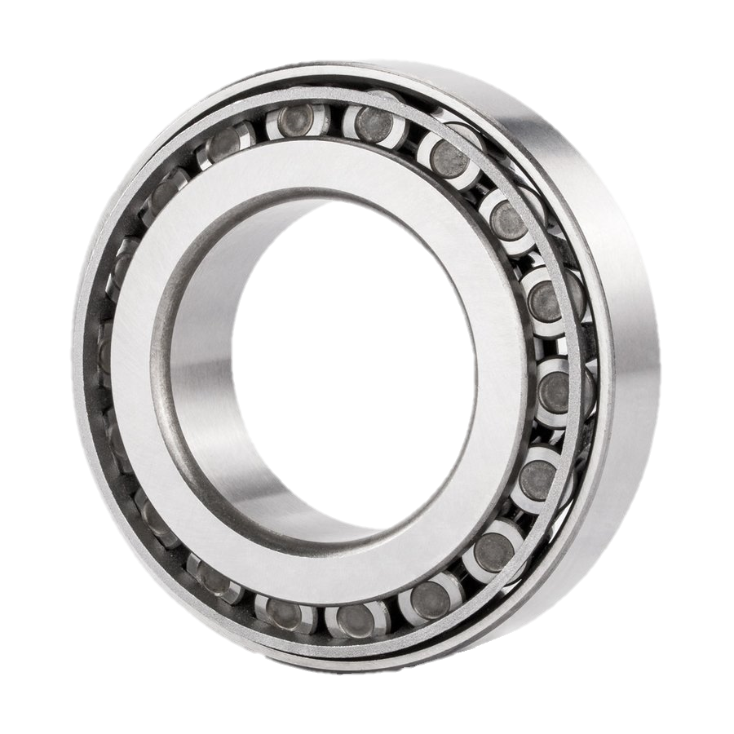

Problem Statement
The goal of this project is to diagnose the specific failure modes when bearing is known degraded.
SKF 32208 tapered roller bearing
Pitch Diameter (D) = 60mm
Roller Diameter (d) = 10mm
Number of Roller (n) = 17
Contact Angle (Φ) = 14.04
Rotating speed of inner race ($f_{i}$) = 800 rpm
Rotating speed of outer race ($f_{o})$ = 0 rpm
https://www.kugellager-express.de/tapered-ball-bearing-32208-40x80x24-75-mm

Slide 6
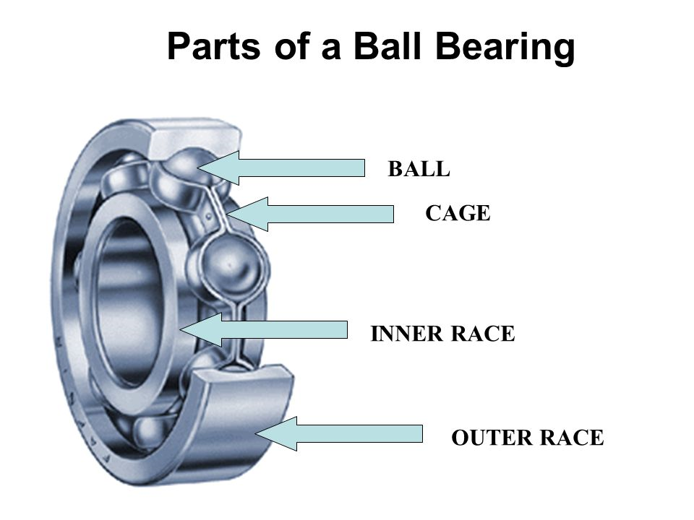
Cases
Healthy
Roller (Ball) damage
Inner race defect
Outer race defect
Inner + Roller
Outer + Roller
Inner + Outer
Inner + Outer + Roller
https://slideplayer.com/slide/5780979/

Slide 7

Parameters
Ball Passing Frequency Outer Race (BPFO)
Ball Passing Frequency Inner Race (BPFI)
Fundamental Train Frequency (FTF)
Ball Spin Frequency (BSF)
D = pitch dia; d = ball dia; $φ$= contact angle;
n = no. of balls
Review of Techniques for Bearings & Gearbox Diagnostics.pdf

Slide 8
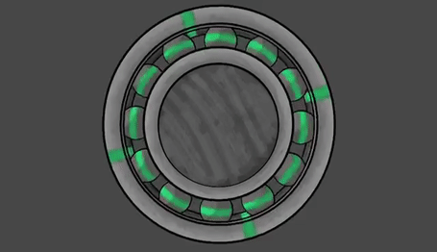
Situations
Bearing Defect
Frequency of Outer Ring Defect (FORD)
Frequency of Inner Ring Defect (FIRD)
Frequency of Ball Defect (FBD)
http://www1.udel.edu/present/Becky/bearing/
https://gfycat.com/lividsarcasticguineapig

Slide 9
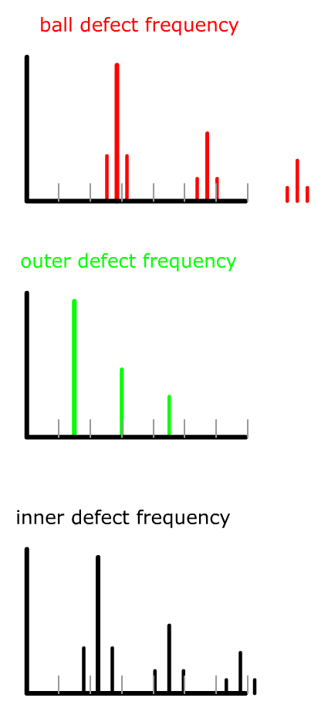
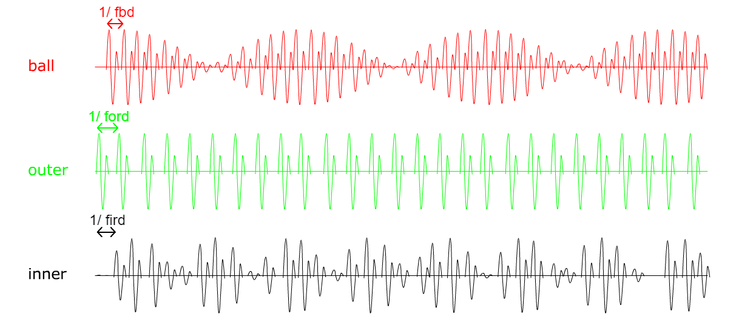
Situations(cont’d)

Slide 10
Solutions
Time Waveform Analysis
Frequency Spectral Analysis
High Frequency Detection (HFD)
Stress Wave Analysis or Spike Energy
Enveloping

Slide 11
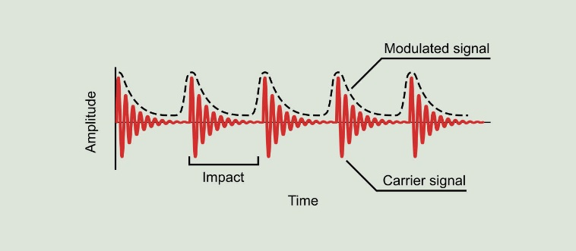
Enveloping
Enveloping is a technique that can extract the modulating signal from an amplitude modulated signal by Hilber transform.
http://www.power-mi.com/content/demodulation-or-envelope-analysis

Slide 12
Feature of bearing fault
Rolling element bearing fault frequencies are generated when a bearing begins to fatigue.
Time domain statistical parameters, such as Root Mean Square Amplitude (RMS), are also calculated from vibration data and monitored for a significant increase in magnitude.
These fault or defect frequencies are calculated using bearing geometry and speed.

Slide 13
Feature of bearing fault(cont’d)
Manually observing the spectrum for increases throughout testing was not feasible due to the fact that these tests often ran unattended. For this reason, a technique was developed to trend the defect frequencies on-line. Using the defect frequencies BPFI, BPFO, BSF, FTF as indexes for the frequency domain data.

Slide 14
Assumptions Made in Bearing Fault Frequencies
1. All balls/rollers are equal in diameter
2. There in pure rolling contact between balls, inner race and outer race.
3. There is no slipping between the shaft and the bearing
4. Outer race is stationary and inner race rotates
Bearing faults create a series of impacts which are amplified by resonances: bearing, sensors, structure etc

Slide 15
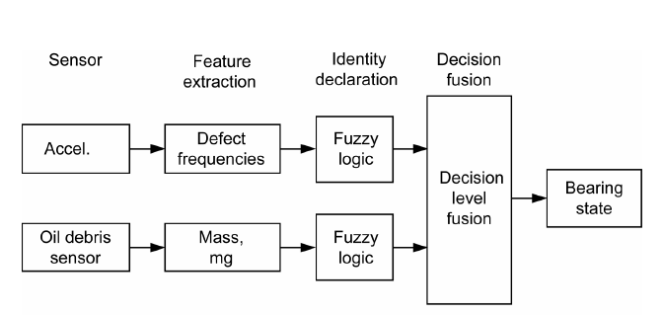
Decision Fusion Analysis
Reference: Dempsey, Paula J., Gary Kreider, and Thomas Fichter. "Tapered Roller Bearing Damage Detection
Using Decision Fusion Analysis." (2006).

Slide 16
Flow chart

Slide 17
Flow chart
SOM
GMM+EM
Data
Preprocessing
Feature extraction
Feature selection
SVM
SOM-MQE
DNN

Slide 18
Bearing dataset

Slide 19
Bearing dataset
training data is given with 2048 tests, as well as labels for all the 2048 tests. Labels are numbers from 1 to 8, and each class has 256 samples, corresponding with normal, roller, inner race, outer race, inner race & roller, inner race & outer race, outer & inner race & roller, and outer race & roller.

Slide 20
Feature extraction
Time domain: Mean、Variance、Skewness、Kurtosis、Entropy、Peak-to-peak、RMS
Frequency domain: BSF、BPFI、BPFO

Slide 21
Feature selection

Slide 22
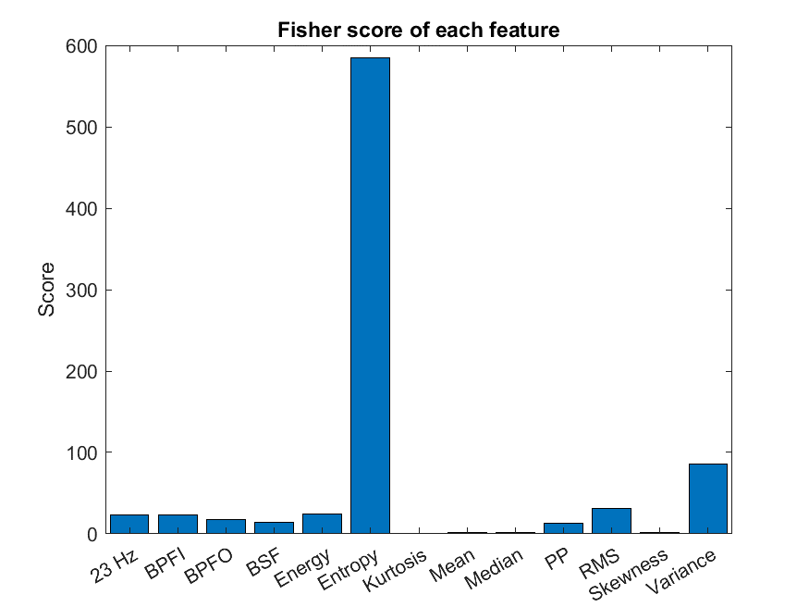
Fisher score

Slide 23
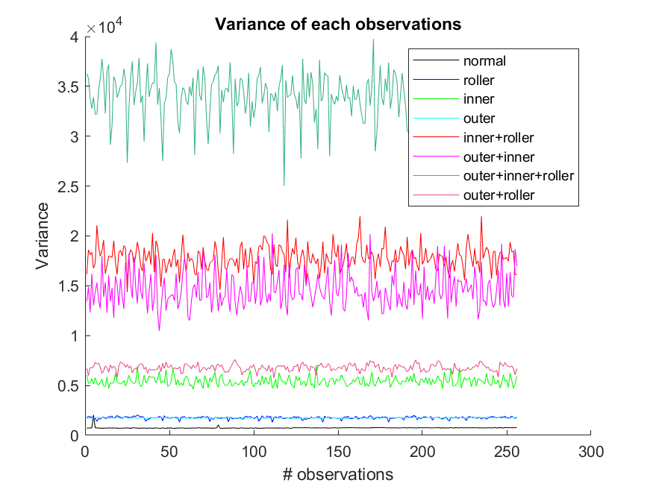
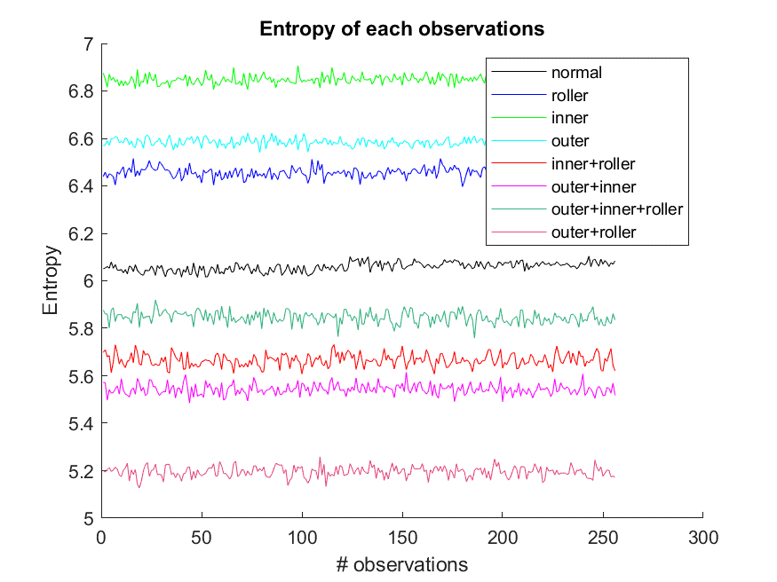
Feature visualization(cont’d)

Slide 24
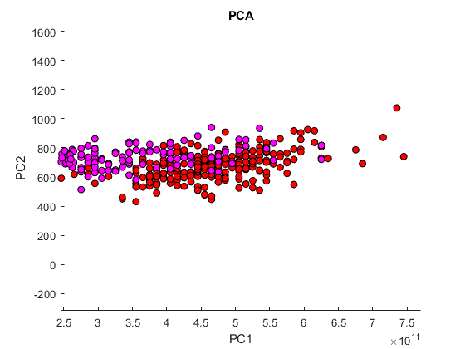
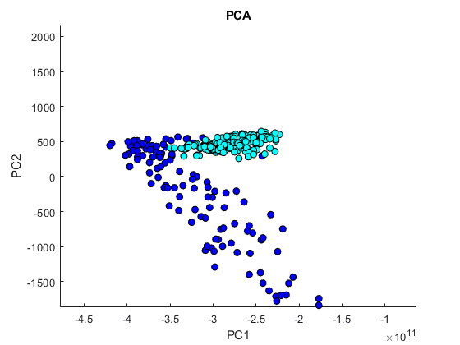
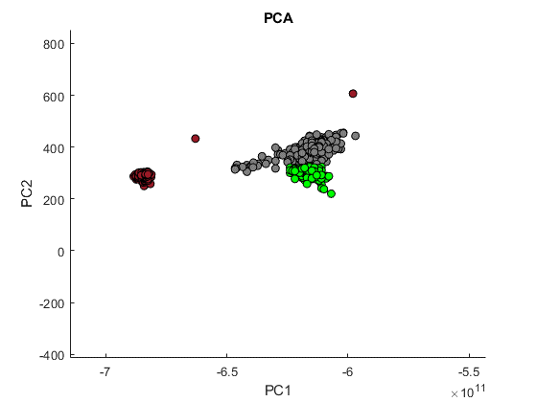
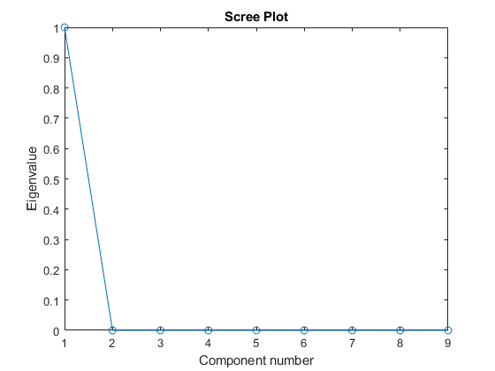
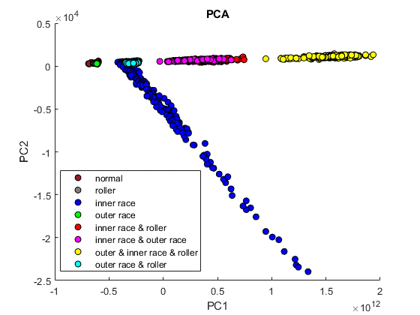
Feature visualization(cont’d)

Slide 25
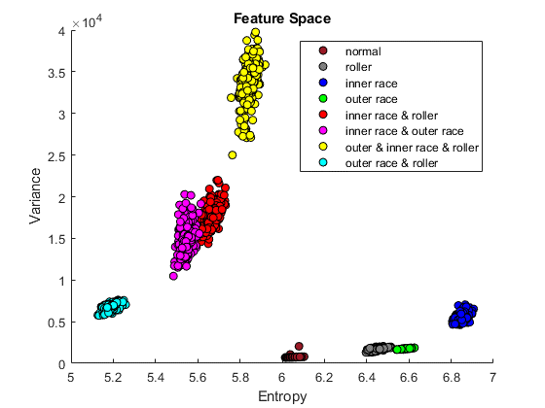
Feature visualization(cont’d)

Slide 26
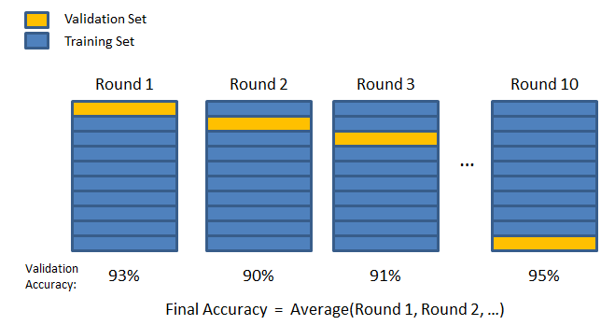
K-fold Cross validation(K=4)

Slide 27
Model training
SOM
SOM-MQE
Support vector machine(SVM)
GMM+EM
Deep neural network(DNN)

Slide 28
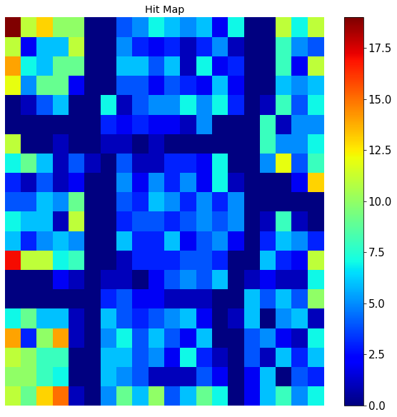
SOM

Slide 29
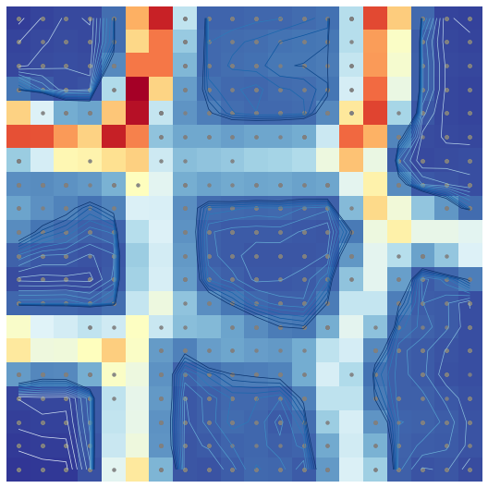
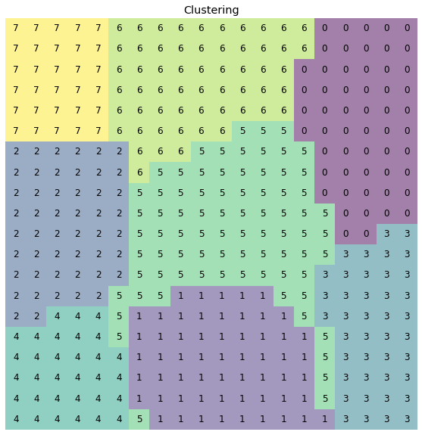
SOM U-Matrix

Slide 30
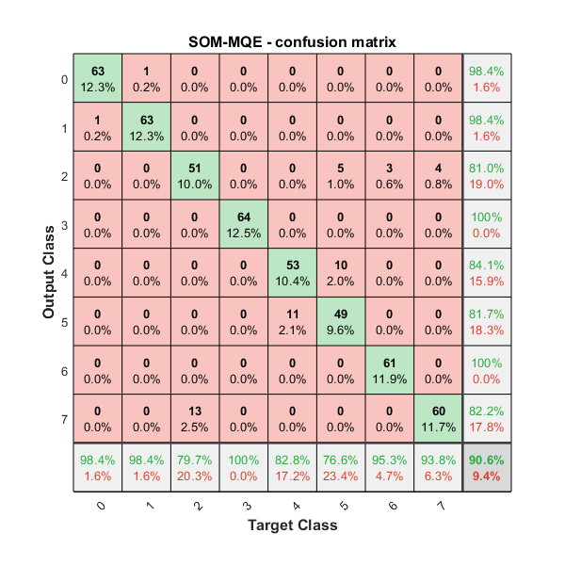
SOM-MQE
validation 1: 0.8457
validation 2: 0.9082
validation 3: 0.8828
validation 4: 0.8867
Total ACC : 0.8809

Slide 31
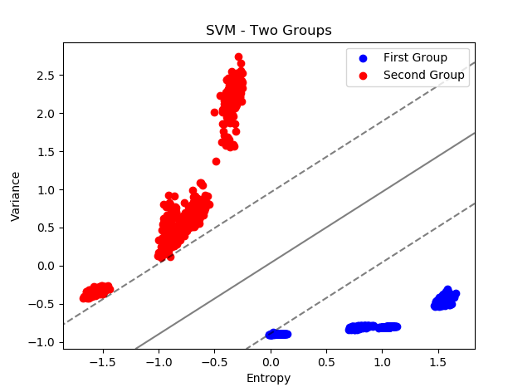
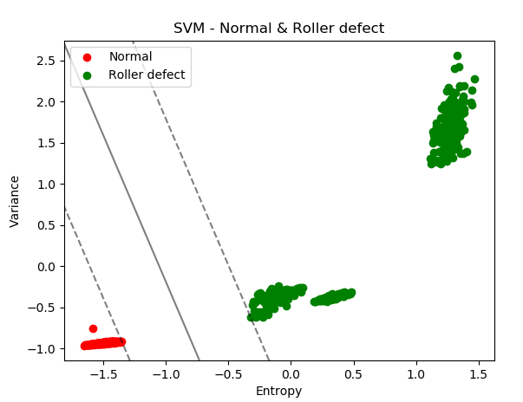
Support Vector Machine (SVM)

Slide 32
Support Vector Machine (SVM)
Target Classes
1
2
3
4
5
6
7
8
1
64 | 0 | 0 | 0 | 0 | 0 | 0 | 0 | 100% 0%
0 | 63 | 1 | 0 | 0 | 0 | 0 | 0 | 98.4% 1.6%
0 | 0 | 60 | 4 | 0 | 0 | 0 | 0 | 93.7% 0%
0 | 0 | 0 | 64 | 0 | 0 | 0 | 0 | 100% 0%
0 | 0 | 0 | 0 | 64 | 0 | 0 | 0 | 100% 0%
0 | 0 | 0 | 0 | 0 | 64 | 0 | 0 | 100% 0%
0 | 0 | 0 | 0 | 0 | 0 | 64 | 0 | 100% 0%
0 | 0 | 0 | 0 | 0 | 0 | 0 | 64 | 100% 0%
100% 0% | 100% 0% | 98.3% 1.7% | 94.1% 5.9% | 100% 0% | 100% 0% | 100% 0% | 100% 0% | 99% 1%
Validation1
Accuracy = 99%
Output Classes
2
3
4
5
6
7
8

Slide 33
Support Vector Machine (SVM)(cont’d)
Target Classes
1
2
3
4
5
6
7
8
1
64 | 0 | 0 | 0 | 0 | 0 | 0 | 0 | 100% 0%
0 | 62 | 2 | 0 | 0 | 0 | 0 | 0 | 96.8% 3.2%
0 | 0 | 64 | 0 | 0 | 0 | 0 | 0 | 100% 0%
0 | 0 | 0 | 64 | 0 | 0 | 0 | 0 | 100% 0%
0 | 0 | 0 | 0 | 64 | 0 | 0 | 0 | 100% 0%
0 | 0 | 0 | 0 | 0 | 64 | 0 | 0 | 100% 0%
0 | 0 | 0 | 0 | 0 | 0 | 64 | 0 | 100% 0%
0 | 0 | 0 | 0 | 0 | 0 | 0 | 64 | 100% 0%
100% 0% | 100% 0% | 96.9% 3.1% | 100% 0% | 100% 0% | 100% 0% | 100% 0% | 100% 0% | 99.4% 0.6%
Validation2
Accuracy = 99.6%
Output Classes
2
3
4
5
6
7
8

Slide 34
Support Vector Machine (SVM)(cont’d)
Target Classes
1
2
3
4
5
6
7
8
1
64 | 0 | 0 | 0 | 0 | 0 | 0 | 0 | 100% 0%
0 | 63 | 1 | 0 | 0 | 0 | 0 | 0 | 98.4% 1.6%
0 | 0 | 64 | 0 | 0 | 0 | 0 | 0 | 100% 0%
0 | 0 | 0 | 64 | 0 | 0 | 0 | 0 | 100% 0%
0 | 0 | 0 | 0 | 64 | 0 | 0 | 0 | 100% 0%
0 | 0 | 0 | 0 | 0 | 64 | 0 | 0 | 100% 0%
0 | 0 | 0 | 0 | 0 | 0 | 64 | 0 | 100% 0%
0 | 0 | 0 | 0 | 0 | 0 | 0 | 64 | 100% 0%
100% 0% | 100% 0% | 98.4% 1.6% | 100% 0% | 100% 0% | 100% 0% | 100% 0% | 100% 0% | 99.8% 0.2%
Validation3
Accuracy = 99.8%
Output Classes
2
3
4
5
6
7
8

Slide 35
Support Vector Machine (SVM)(cont’d)
Target Classes
1
2
3
4
5
6
7
8
1
64 | 0 | 0 | 0 | 0 | 0 | 0 | 0 | 100% 0%
0 | 63 | 1 | 0 | 0 | 0 | 0 | 0 | 98.4% 1.6%
0 | 0 | 64 | 0 | 0 | 0 | 0 | 0 | 100% 0%
0 | 0 | 0 | 64 | 0 | 0 | 0 | 0 | 100% 0%
0 | 0 | 0 | 0 | 64 | 0 | 0 | 0 | 100% 0%
0 | 0 | 0 | 0 | 0 | 64 | 0 | 0 | 100% 0%
0 | 0 | 0 | 0 | 0 | 0 | 64 | 0 | 100% 0%
0 | 0 | 0 | 0 | 0 | 0 | 0 | 64 | 100% 0%
100% 0% | 100% 0% | 98.4% 1.6% | 100% 0% | 100% 0% | 100% 0% | 100% 0% | 100% 0% | 99.8% 0.2%
Validation4
Accuracy = 99.8%
Average Accuracy = 99.46%
Output Classes
2
3
4
5
6
7
8

Slide 36
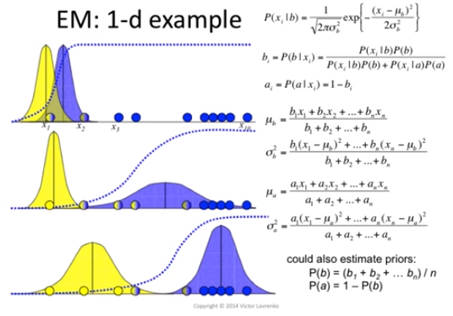
GMM+EM
Reference:https://www.youtube.com/watch?v=XLKoTqGao7U

Slide 37
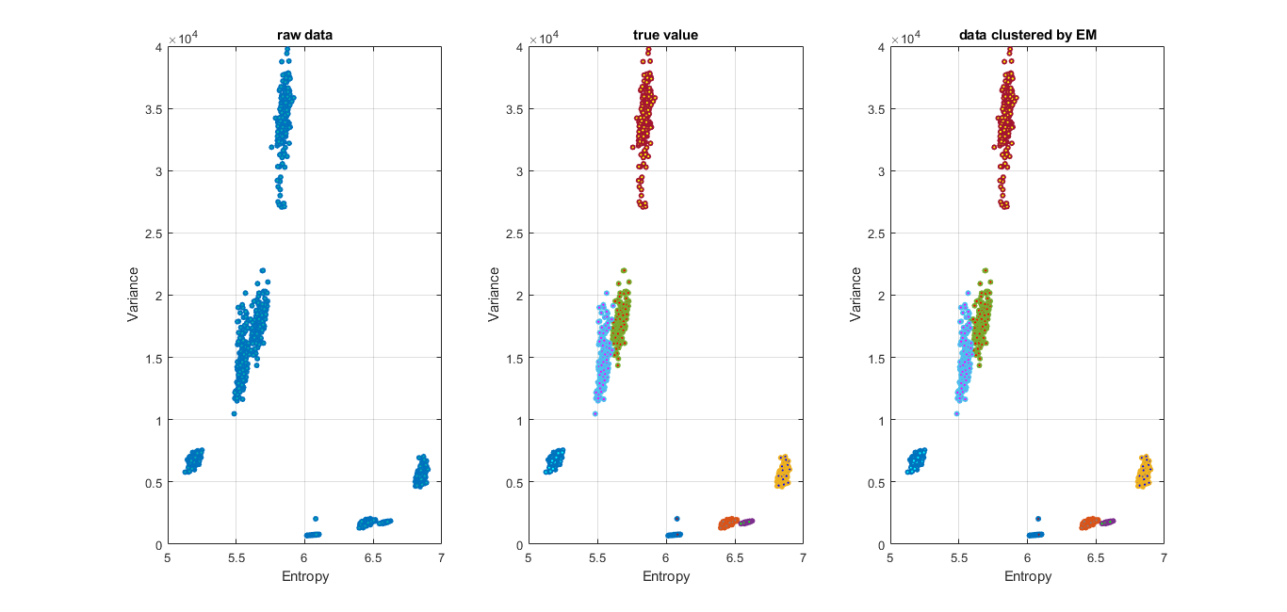
GMM+EM(cont’d)

Slide 38
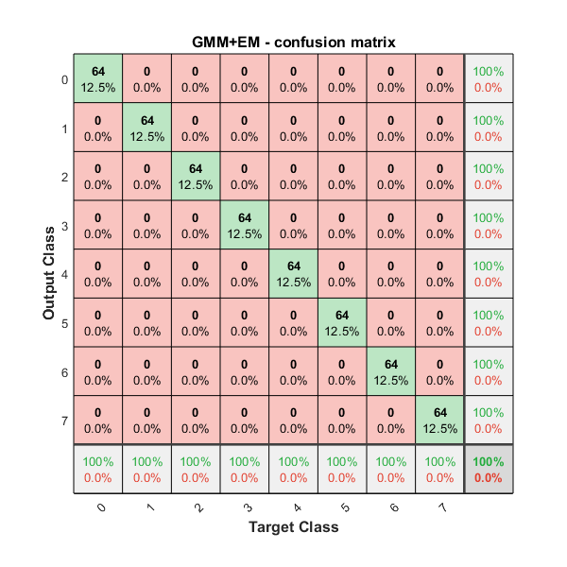
GMM+EM(cont’d)
validation 1: 0.9961
validation 2: 1.0
validation 3: 0.9980
validation 4: 0.9980
Total ACC : 0.9980

Slide 39
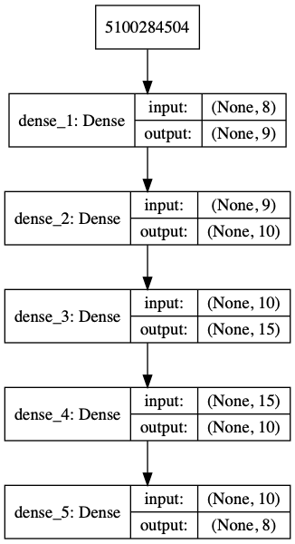
Deep Neural Network

Slide 40
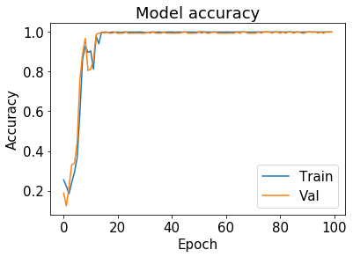
Deep Neural Network(cont’d)

Slide 41
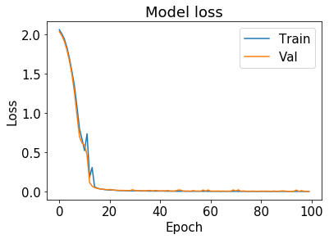
Deep Neural Network(cont’d)

Slide 42
Deep Neural Network(cont’d)
Validation accuracy 0: 0.9902343843132257
Validation accuracy 1: 0.9960937537252903
Validation accuracy 2: 1.0
Validation accuracy 3: 0.9980468768626451

Slide 43
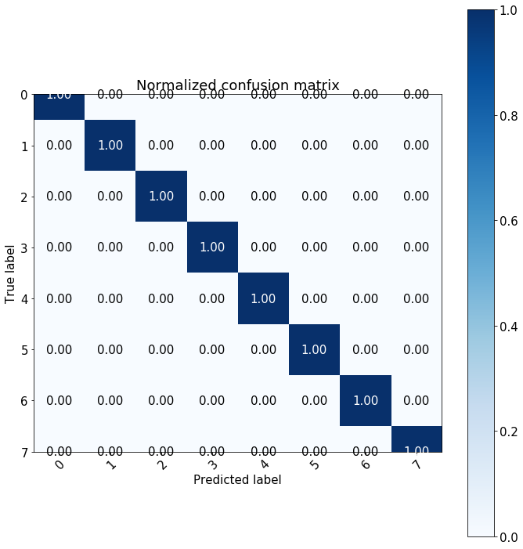
Deep Neural Network(cont’d)

Slide 44
Comparison
 | SOM-MQE | SVM | GMM+EM | DNN
accuracy | 0.8809 | 0.9946 | 0.9980 | 0.9961

Slide 45
conclusion
Time domain feature is better than frequency domain.
According to fisher criterion, entropy is the best feature to diagnosis bearing fault.
The original feature space such as entropy and variance is more distinguishable than PCA.
The GMM with EM algorithm obtain the best accuracy to determine which condition of bearing is based on the result of K-fold cross validation.

Slide 46
Thanks for your listening

